Slide 1

Customer Shopping Behavior Analysis
Analyzing 3,900 purchases to uncover spending patterns, preferences, and subscription behavior for strategic business decisions.

Slide 2

Project Overview
Goal
Data
Uncover insights into spending patterns, customer segments, product preferences, and subscription behavior.
Transactional data from 3,900 purchases across various product categories.
Purpose
Guide strategic business decisions and future-proof growth.

Slide 3
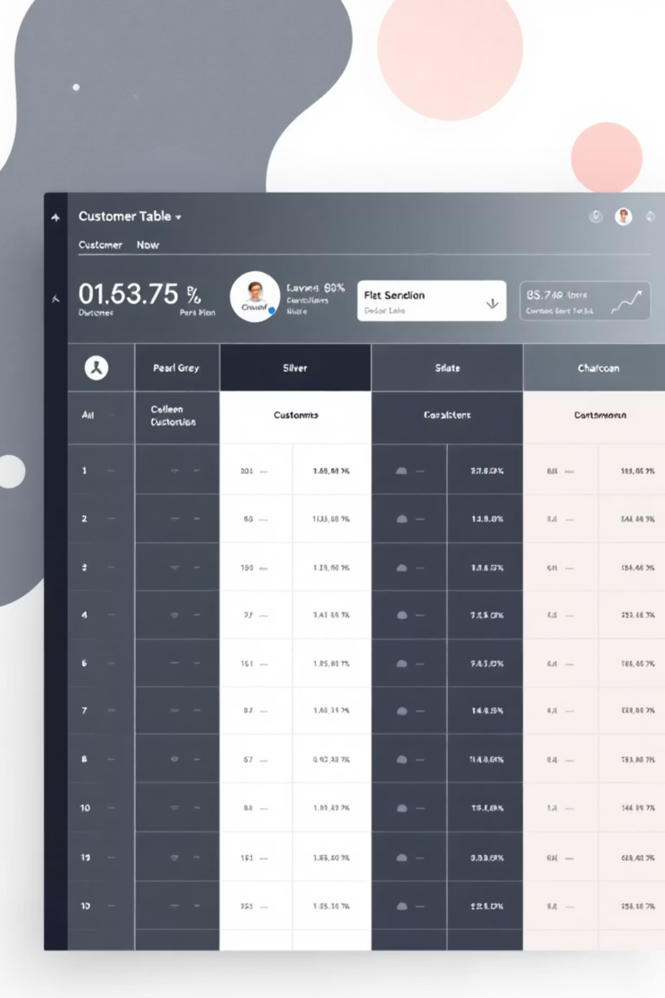
Dataset Summary
3,900
18
37
Rows
Columns
Missing Values
Total purchases analyzed.
Key features for analysis.
In Review Rating column.
Key features include demographics, purchase details, and shopping behavior.

Slide 4
Exploratory Data Analysis (Python)
01
02
Data Loading
Initial Exploration
Imported dataset using pandas.
Checked structure and summary statistics.
03
04
Missing Data
Column Standardization
Imputed nulls in Review Rating.
Renamed columns to snake case.
05
06
Feature Engineering
Database Integration
Created age groups and purchase frequency.
Loaded cleaned data to PostgreSQL.

Slide 5




Data Analysis (SQL)
Structured analysis in PostgreSQL to answer key business questions.
Revenue by Gender
High-Spending Discount Users
Female: $75,191, Male: $157,890
Identified 839 customers.
Top 5 Products by Rating
Gloves, Sandals, Boots, Hat, Skirt.

Slide 6

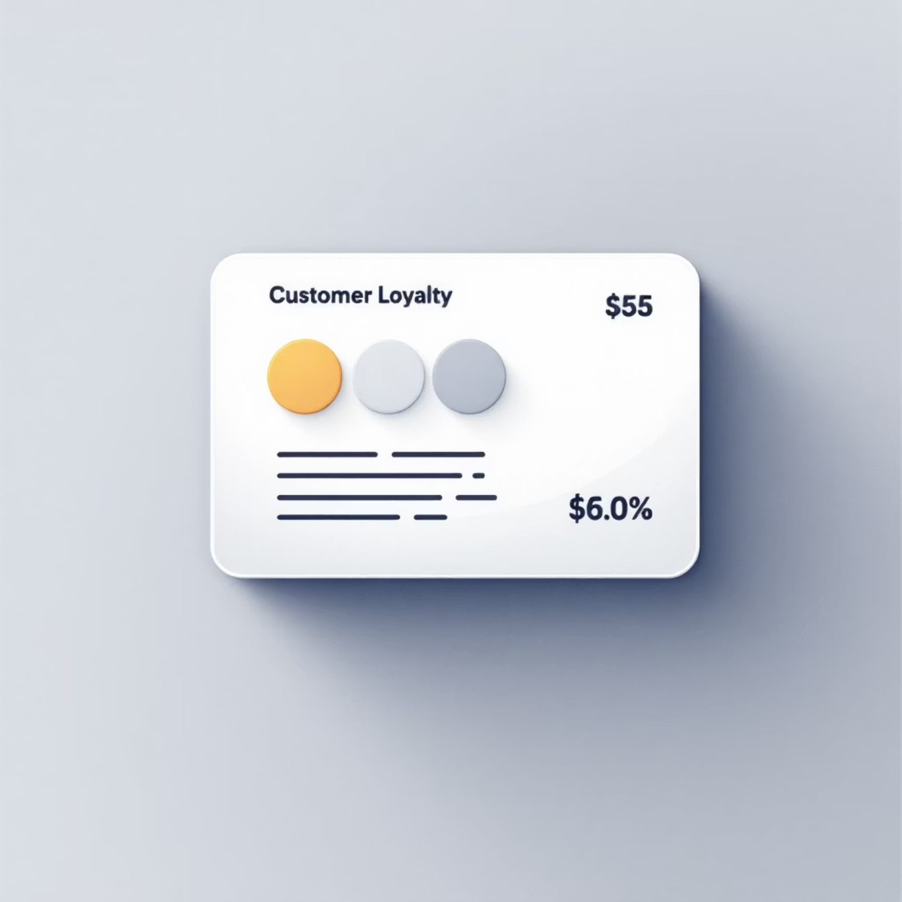
SQL Insights: Shipping & Subscriptions
Shipping Type Comparison
Subscribers vs. Non-Subscribers
Standard: $58.46 avg. purchase
Subscribers: 1,053 customers, $59.49 avg. spend
Express: $60.48 avg. purchase
Non-Subscribers: 2,847 customers, $59.87 avg. spend

Slide 7

SQL Insights: Product & Customer Focus
1
2
3
Discount-Dependent Products
Customer Segmentation
Repeat Buyers & Subscriptions
Loyal (3116), Returning (701), New (83).
Hat (50%), Sneakers (49.66%), Coat (49.07%), Sweater (48.17%), Pants (47.37%).
958 repeat buyers are subscribers.

Slide 8
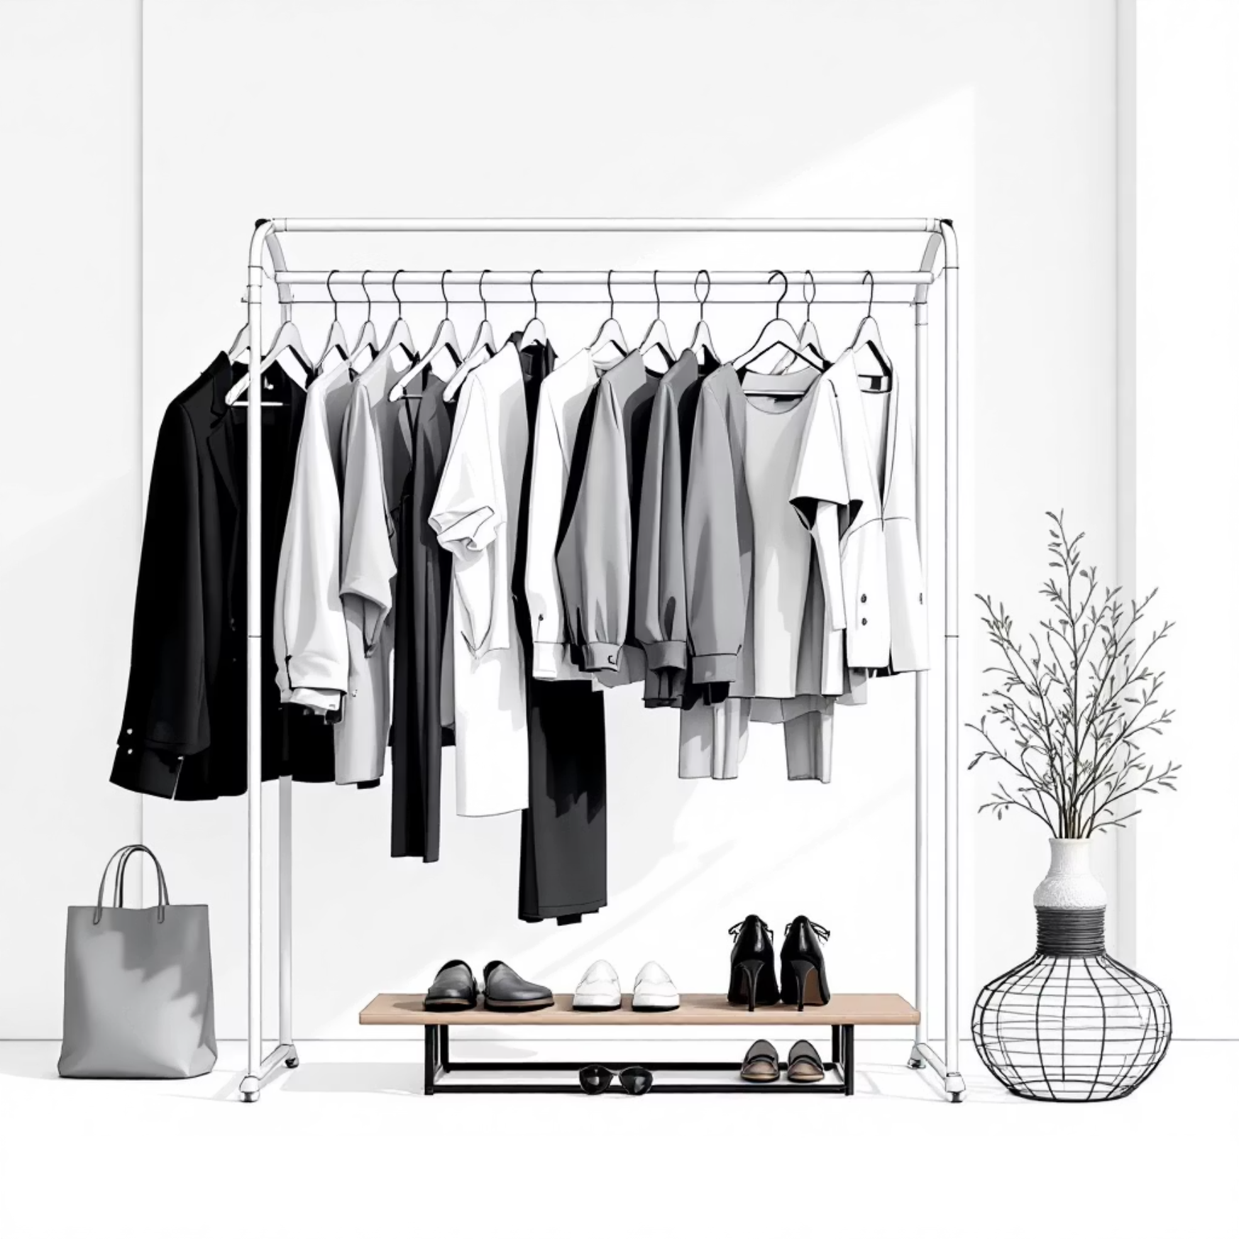
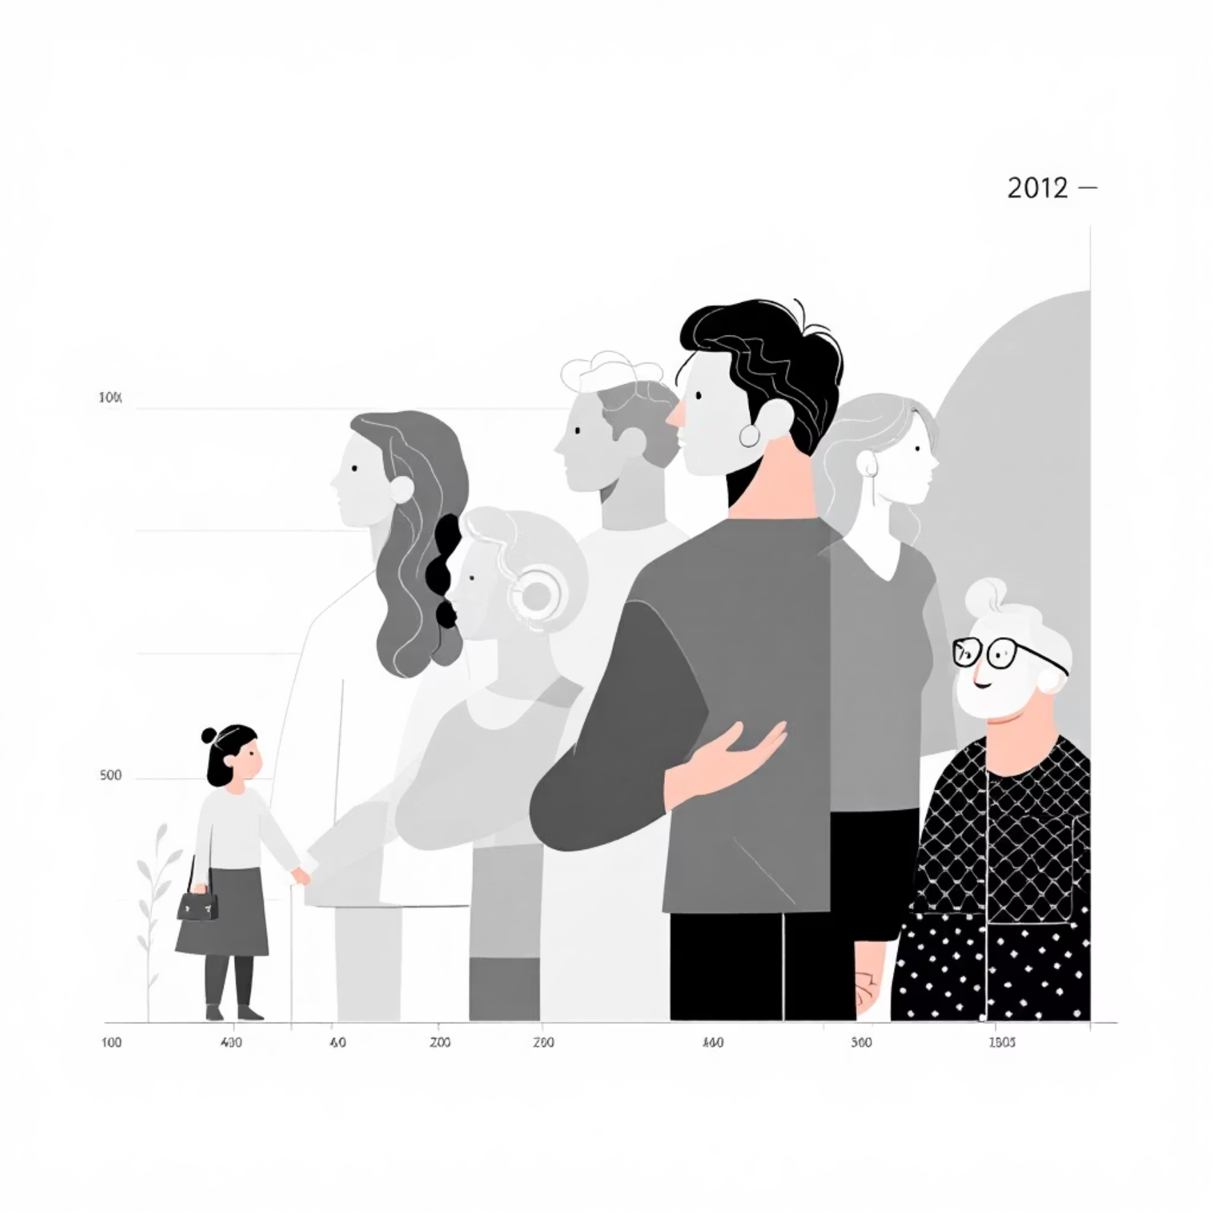
SQL Insights: Top Products & Revenue by Age
Top 3 Products per Category
Revenue by Age Group
Accessories: Jewelry, Sunglasses, Belt
Young Adult: $62,143
Clothing: Blouse, Pants, Shirt
Middle-aged: $59,197
Footwear: Sandals, Shoes, Sneakers
Adult: $55,978
Outerwear: Jacket, Coat
Senior: $55,763

Slide 9
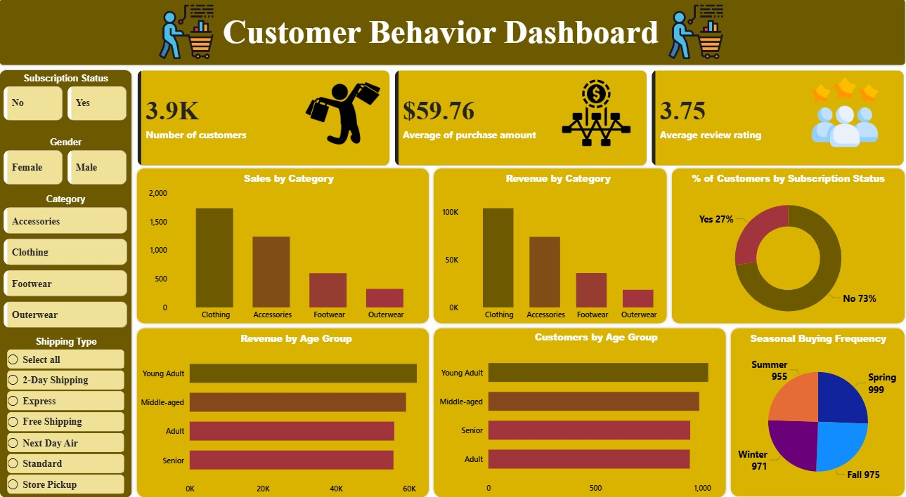
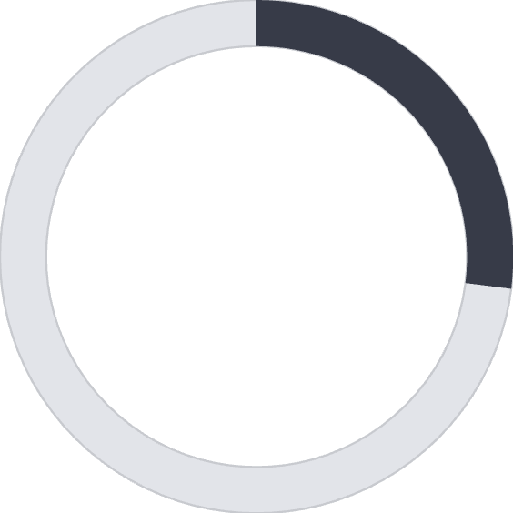


Power BI Dashboard
Interactive dashboard for visual insights.
27%
$59.76
3.75
Subscribers
Avg. Purchase
Avg. Review
Percentage of total customers.
Average amount spent per customer.
Average customer review rating.

Slide 10





Business Recommendations
Boost Subscriptions
Promote exclusive benefits.
Customer Loyalty
Reward repeat buyers.
Review Discount Policy
Balance sales with margin.
Product Positioning
Highlight top-rated items.
Targeted Marketing
Focus on high-revenue groups.

